Slide 1
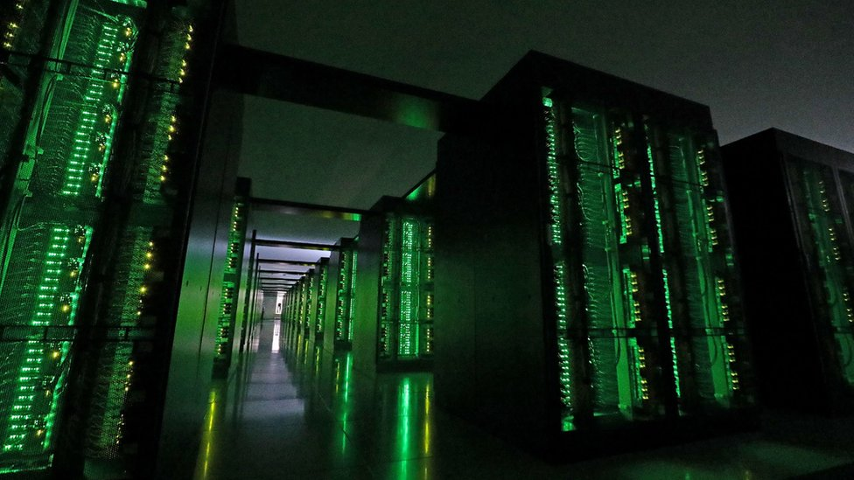
The
Ultimate SuperComputer-on-a-Chip for Acceleration of
Massive Big Data and Highly Iterative Algorithms
Veljko Milutinović
Special Thanks to Oskar Mencer, Honorary Treasurer of Academia Europaea

Slide 2
Classification of Acceleration Approaches (12):
Criteria: Technology + Paradigm
T=NOT + P=NOT (2): Brute Force
Faster silicon + more cores (Multicore CPUs + Manycore GPUs)=> . Memory-oriented vs Messaging-oriented progModels (DSM + MPC)
T=YES + P=NOT (2): Reincarnated progModels
GaAs3rd5th(vonNeumannISA85)/CdTe2nd6th(TuringMachine)=>
ControlFlow for Special Missions (SpeedUp + RadiationHardness)
T=NOT + P=YES (4): ExecutionGraph progModels for min/max edges
Silicon + DataFlow (MaxDFE + GoogleTPU) or DataFly (IoT/WSN)
Programming models based on creation of topological computing!
T=YES + P=YES (4): Creating New Algebras for New Basic Operations
PhysMat (Optical + Quantum) + BioChem (Chemical + Molecular)
Programming models based on creation of new algebras!
Creativity: From Turing and vonNeumann till Łukasiewicz and Hinton.
2/5

Slide 3
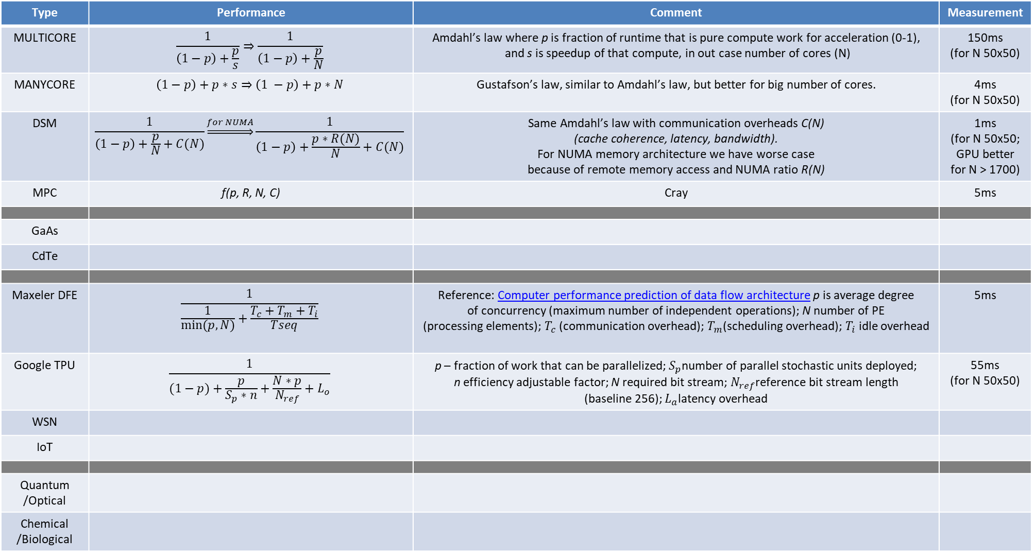
Analysis of the Algorithm X in the Context of Selected Emerging Computing Paradigms:
[Acceleration vs Entrepreneurship, A vs E]
Type | Performance | Comment | Measurement
MULTI CORE |  | Amdahl’s law where p is fraction of runtime that is pure compute work for acceleration (0-1), and s is speedup of that compute, in out case number of cores (N) | 100ms (for N 50x50)
MANY CORE |  | Gustafson’s law, similar to Amdahl’s law, but better for big number of cores. | 4ms (for N 50x50)
DSM |  | Same Amdahl’s law with communication overheads C(N) (cache coherence, latency, bandwidth). For NUMA memory architecture we have worse case because of remote memory access and NUMA ratio R(N) | 2ms (for N 50x50; GPU better for N > 1700)
MPC | f(p, R, N, C) | Cray | 1ms
Orthodox approaches!
3/5

Slide 4
GaAs | Σπ | Von Neumann
GaAs CdTe | lim Σπ vs proto | vonNeumann vs Turing | 100ns
Maxeler DFE |  |  | 10ns
Google TPU |  |  | 1ns (for N 50x50)
IoT | SP |  | 10ps
WSN | lim SP |  | 1ps
Quantum /Optical | α | Ivan Boskovic, Stefan Bukorovic, Mladen Colakovic, Vuk Djordjevic, David Milinkovic | 1fs (femtosec)
Chemical /Biologic | β | Nikola Nikolic, Lazar Radosavljevic, Nikola Ristic, Pavle Sarenac, Uros Savurdic | 1as (attosecs)
Unorthodox approaches!
4/5

Slide 5
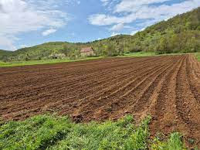
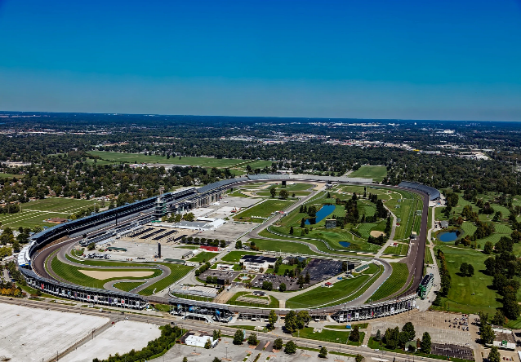


Combining: QC/OC vs GaAs vs DF vs ALL
[Synergizing the xParadigms: 12A + 12E]
DARPA [A12]
A16Z [E12]
5/5

Slide 6
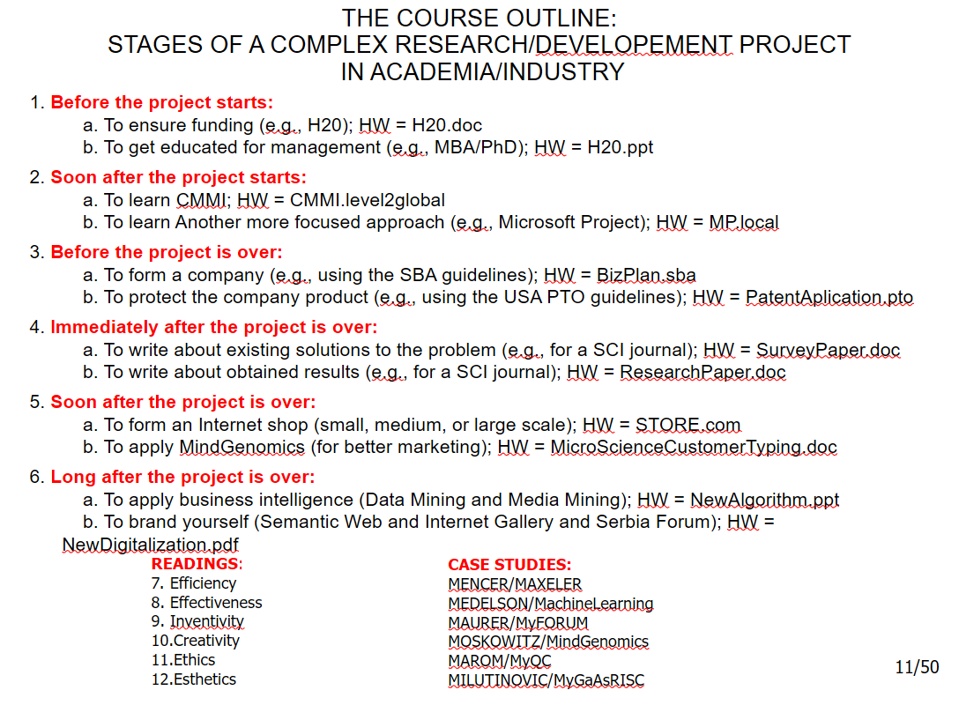

Slide 7
